Slide 1
College Trigonometry
Barnett/Ziegler/Byleen
Chapter 4

Slide 2
Chapter 4 – section 1
Basic Trig Identities

Slide 3
Identity vs infinite solution
Identity is guaranteed to be true for all values
Infinite solutions are not guaranteed for all values
An Identity HAS infinite solutions. An equation with infinite solutions is not an identity
X + 5 = 5 + X is an identity
x > 5 is an infinite solution
y = 3x + 5 has infinite solutions
Identities can be proved true for all numbers

Slide 4
Pythagorean Identities
From unit circle and simple substitution we have:
cos²(x) + sin²(x) = 1
tan(x) = sin(x)/cos(x)
cot(x) = cos(x)/sin(x)
sec(x) = 1/cos(x)
csc(x) = 1/sin(x)
Note: the argument of the functions are identical
cos²(a) + sin²(b) ≠ 1

Slide 5
Using identities to find exact values
cos(x) = 1/5 then cos²(x) + sin²(x) = 1
tells us sin(x) = ± $\sqrt{24}$/5
Because of signs, it is not sufficient to state one trig value and ask for the corresponding trig ratios - either a second trig value must be given that conveys sign information or the value of x must be restricted
In this problem if both cos(x) and sin(x) are given then the other 4 values can be found.

Slide 6

More examples
tan(x) = 2/3 and sec(x) = -$\sqrt{13}$/3
sec(x) = -5/$\sqrt{11}$ 𝜋 /2 < x < 𝜋

Slide 7
Simplifying trig expressions with algebra and known identities
It is important to recognize that sin(x) is a single number
All trig ratios can be written in terms of cos and sin - this allows trig expressions to appear in various forms

Slide 8

Examples
Simplify
(tan x)(cos x)
(sec x)(cot x)(sin x)
(1+ sin x)(1 - sin x)
(1 – tan x)²
$\frac{\sec^{2}x −1}{\sin{x}}$

Slide 9
Negative identities
sin(-x) = - sin(x)
cos(-x) = cos(x)

Slide 10
Evaluating using neg identities
Given sin(-x) = .2983 then sin (x) =
Given tan x = 2.56 then tan (-x) =
Simplify cos(-x)tan(x)sin(-x)

Slide 11
Chapter 4 – section 2
Verifying trig identities

Slide 12
Verifying Trig identities
An equation is called an identity when you can transform one side into the other side using known facts.
cos²(ө) + sin²(ө) = 1 is an identity because
1. Given (x,y), a point on the unit circle
2. cos(ө) = x
3. sin(ө) = y
Simplifying using trig identities creates new trig identities
When given an equation that is claimed to be a trig identity – proving that it is an identity is called verifying the identity –
This is not quite the same as simplifying. Both sides can be complex instead of simple - it is a “morphing” process by which you reshape the equation showing ALL steps needed to make the change.

Slide 13
Hints
Break everything down into sin and cos and use algebra to rearrange and rebuild the new expression
Ex. (sec(x) - 1)(sec(x) + 1) = tan²(x)
Work both ends towards each other
Ex. $\frac{1}{1+\cos{r}}= \csc^{2}\left(r\right)−\csc\left(r\right)cot⁡(r)$

Slide 14
Examples

Slide 15
Chapter 4 – section 3
Sum of angles

Slide 16
Sum and difference identities
cos(x – y) ≠ cos(x) – sin(y) for all values of x and y (is not an identity)
??? What does it equal

Slide 17
Approach question as proof
(e,f)
Ө - ф
(a,b)
ө
(c,d)
ф
ф
Ө - ф
ө

Slide 18
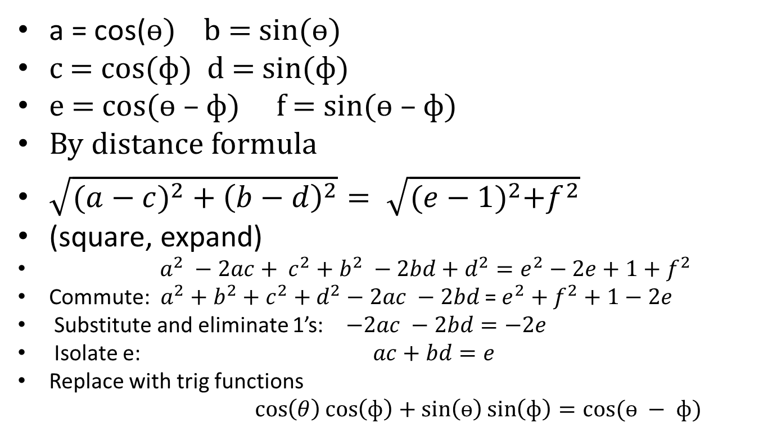
Proof continued
a = cos(ө) b = sin(ө)
c = cos(ф) d = sin(ф)
e = cos(ө – ф) f = sin(ө – ф)
By distance formula
$\sqrt{({a−c)}^{2}+{\left(b−d\right)}^{2}}= \sqrt{{(e−1)}^{2}+f^{2}}$
(square, expand)
$a^{2} −2ac+ c^{2}+b^{2} −2bd+d^{2}=e^{2}−2e+1+f^{2}$
Commute: $a^{2}+b^{2}+c^{2}+d^{2}−2ac −2bd$ =$e^{2}+f^{2}+1−2e$
Substitute and eliminate 1’s: $−2ac −2bd=−2e$
Isolate e: $ac+bd=e$
Replace with trig functions
$\cos\left(θ\right)\cos\left(ф\right)+\sin\left(ө\right)\sin\left(ф\right)=cos⁡(ө − ф)$

Slide 19
Using the sum identity
Finding exact values
given cos(ө) = $\frac{\sqrt{12}}{5}$ and $cos\left(φ\right)=\frac{2}{3}$
sin(ө)= ± sin(ф) ±
so I must determine which ?
given 90< ө < 0 and 0< ф <-90
find cos($θ−φ)$
find cos(15⁰)

Slide 20
Co – function identities
From triangle definitions we know
$\sin\left(x\right)=cos\left(\frac{π}{2}−x\right)$
$tan⁡(x)=cot\left(\frac{π}{2}−x\right)$
$\sec\left(x\right)=csc\left(\frac{π}{2}−x\right)$
These identities can now be proved for all values of x

Slide 21
Be able to prove the co-function identities

Slide 22
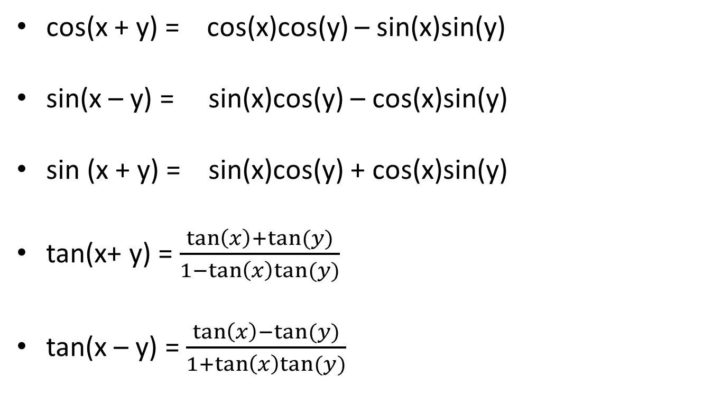
Be able to prove
cos(x + y) = cos(x)cos(y) – sin(x)sin(y)
sin(x – y) = sin(x)cos(y) – cos(x)sin(y)
sin (x + y) = sin(x)cos(y) + cos(x)sin(y)
tan(x+ y) = $\frac{\tan\left(x\right)+tan⁡(y)}{1−\tan\left(x\right)tan⁡(y)}$
tan(x – y) = $\frac{\tan\left(x\right)−tan⁡(y)}{1+\tan\left(x\right)tan⁡(y)}$

Slide 23
Be able to use sum and difference identities to verify identities

Slide 24
Chapter 4 – section 4
Double angel/ half angle identities

Slide 25
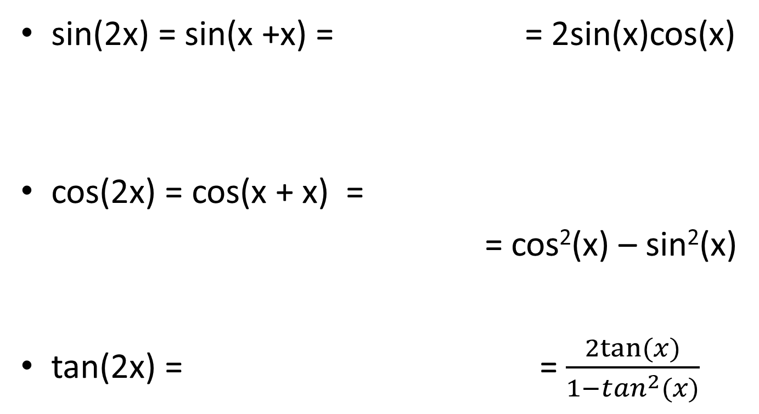
Double angle
sin(2x) = sin(x +x) = = 2sin(x)cos(x)
cos(2x) = cos(x + x) =
= cos²(x) – sin²(x)
tan(2x) = = $\frac{2tan⁡(x)}{1−\tan^{2}(x)}$

Slide 26
Half angle identities derived from double angle
Since cos(2u) = 1 – 2sin²(u) then
let u = x/2 then
cos(x) = 1 – 2sin²($\frac{x}{2}$)
solving this equation for sin(x/2) yields
$sin\left(\frac{x}{2}\right)=±\sqrt{\frac{1−cos⁡(x)}{2}}$
Since cos(2u) = 2cos2(u) – 1 also
cos(x) = $2\cos^{2}\left(\frac{x}{2}\right) −1$
And solving this yields
$cos\left(\frac{x}{2}\right)=±\sqrt{\frac{\cos\left(x\right)+1}{2}}$
Note: sign choice is dependent on the quadrant in which x/2 lies

Slide 27
Half angle tan identity

Slide 28
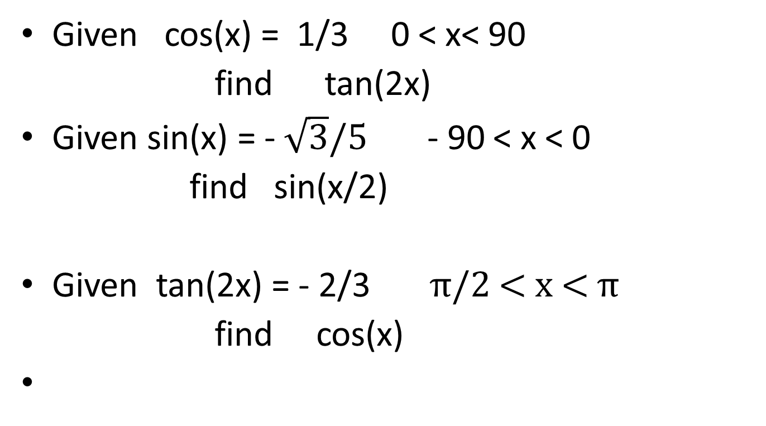
Using the identities
Given cos(x) = 1/3 0 < x< 90
find tan(2x)
Given sin(x) = - $\sqrt{3}/5$ - 90 < x < 0
find sin(x/2)
Given tan(2x) = - 2/3 π/2 < x < π
find cos(x)

